Slide 1
Design Patterns
20APC4584 – T.P.Indunil

Slide 2
What are design patterns?
general reusable solutions to common problems that occur during software development.
There are 3 major design patterns.
01.Creational pattern
02.Structural pattern
03.Behavioral pattern

Slide 3
01.Creational Pattern
These patterns deal with object creation mechanisms, trying to create objects in a manner suitable to the situation.
Eg:- 01. factory method
02. Abstract method
03.Builder
04.Prototype
05.Singleton

Slide 4
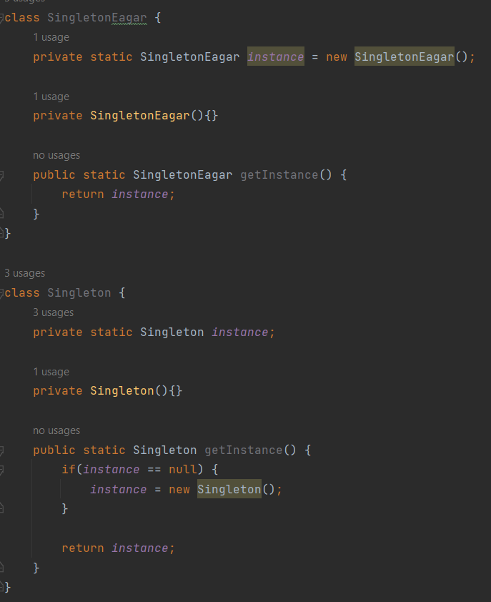
Singleton pattern

Slide 5
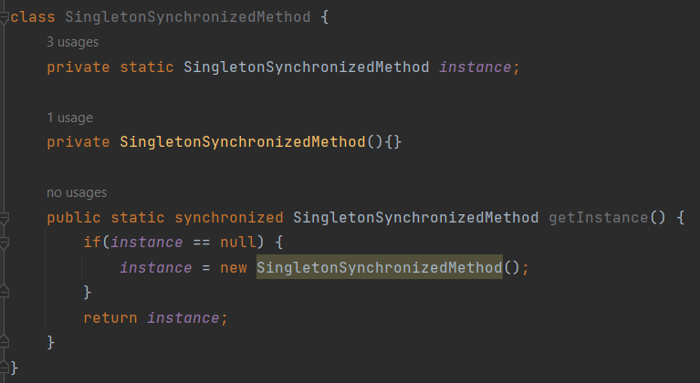
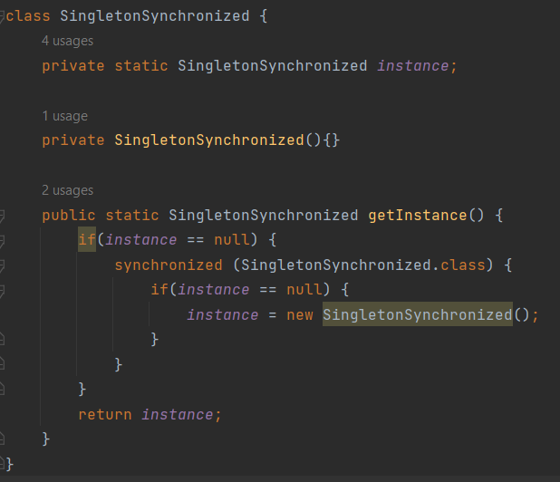

Slide 6
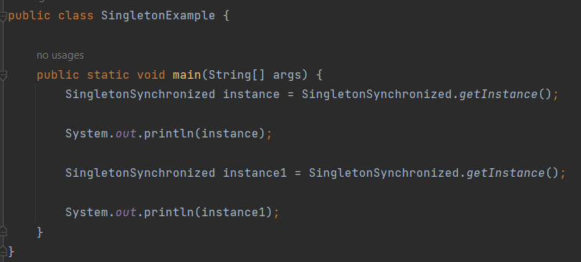

Slide 7
02.Structural Pattern
A structural pattern in software design describes how classes and objects can be composed to form larger structures while maintaining flexibility and efficiency.
Eg :- 01.Adapter
02.Façade
03.Proxy
04.Composite
05.Decorator

Slide 8
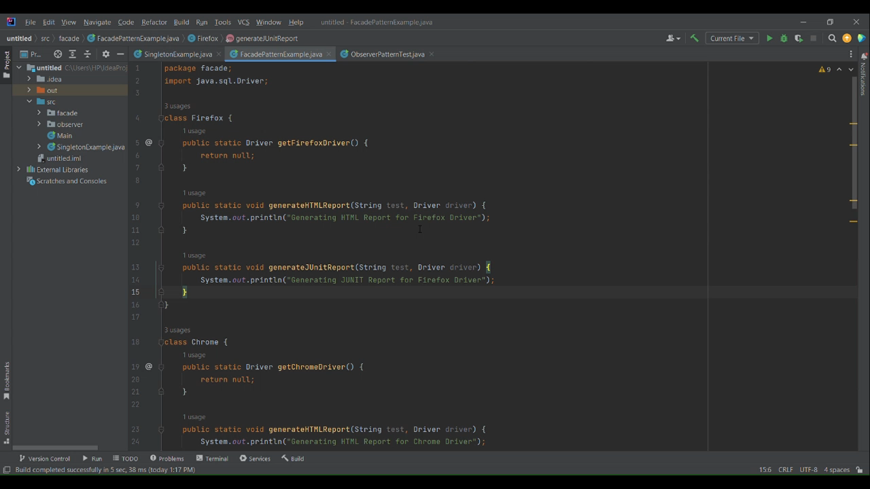
Facade

Slide 9
03.Behavioral Pattern
A behavioral pattern in software design focuses on how objects interact and communicate, defining the responsibility and algorithms for performing specific tasks within a system.
Eg :- 01. Observer
02. Iterator
03. Command
04. Strategy
05. Mediator

Slide 10
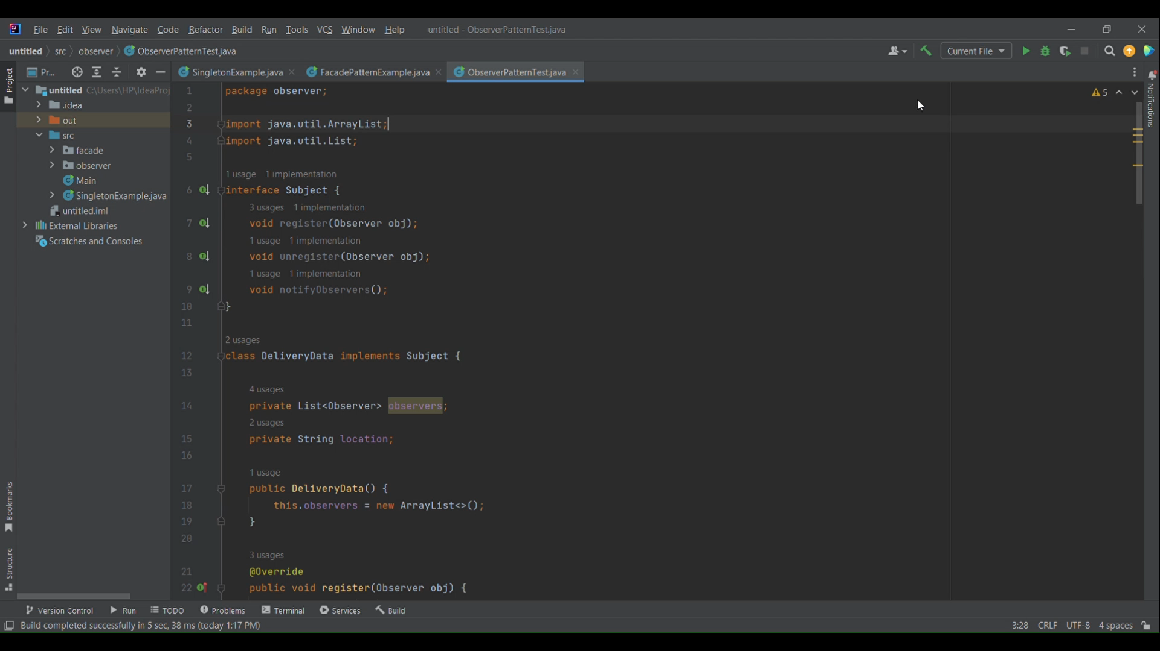
Observer

Slide 11
Thank you

